Slide 1
QUANTUM AUTO-ENCODERs vERSUs CLASSICAL AUTO-ENCODERs
BUILDING AND EVALUATING A QUANTUM AUTO-ENCODER AGAINST A CLASSICAL AUTO-ENCODER

Slide 2
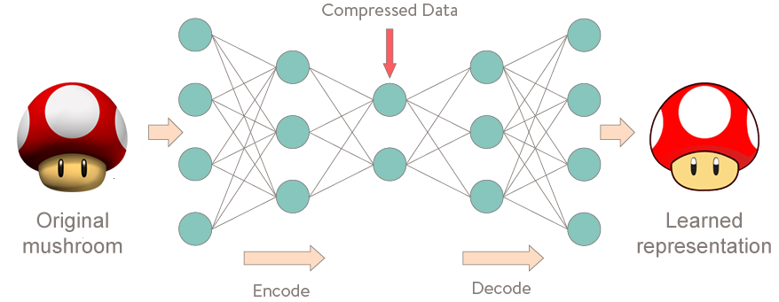
Auto-encoders
Image: http://curiousily.com/data-science/2017/02/02/what-to-do-when-data-is-missing-part-2.html
Notes:
What IS an auto-encoder?
An auto-encoder is a program that allows one to not only compress data from its higher dimension representation to its lower dimension representation but also reconstruct data from its lower dimension representation.
It consists of 2 parts: An encoder and a decoder.
Encoder: Transforms data to its lower dimension representation
Decoder: Retrieves data from its lower dimension representation

Slide 3

Uses of auto-encoders
Collaborative Filtering (https://github.com/NVIDIA/DeepRecommender)
Compression
Matrix factorization
Notes:
Collaborative Filtering: Gives you recommendations on Netflix. See NVIDIA reference. This is the main use.
A Canadian scientist made a connection between auto-encoders and matrix factorization that is pretty cool.

Slide 4
Motivation
Auto-encoders are an important component to many different machine learning algorithms
Classical Auto-Encoders are not capable of representing quantum states
Notes:
Recommender algorithms especially
This makes it difficult to compress these states onto lower dimensions for storage.

Slide 5
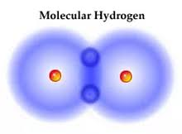
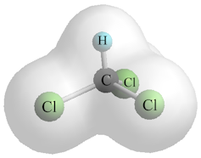
Symmetry
Notes:
The quantum auto-encoder is able to utilize the symmetry that exists in simple molecules such as H₂ in order to compress data. Molecules that do not make use of all of their degrees of freedom can be easily encoded

Slide 6
Method Overview
Prepare
Prepare input states
Create
Create an encoding architecture
Define
Define a cost function
Optimize
Optimize the architecture parameters
Decode
Decode the encoded data
Compare
Compare the yield/accuracy of the architecture

Slide 7
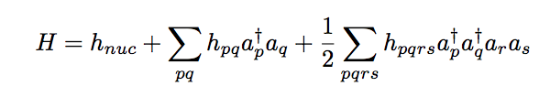
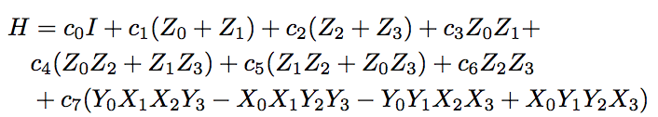
Preparing input states
Find ground states of H₂ molecule for different Hamiltonians
Use the Jordan-Wigner transform to transform the molecular Hamiltonian into four qubits

Slide 8
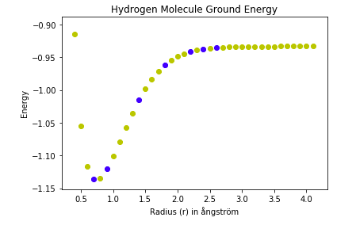
Blue Ground Energies map to training ground states
Ground States obtained via OpenFermion API

Slide 9
Encoding: The Architecture
Romero, Jonathan, Jonathan Olson and Alan Aspuru-Guzik. Quantum autoencoders for efficient compression of quantum data. Scientific Paper. Harvard University. Cambridge, 2017.

Slide 10
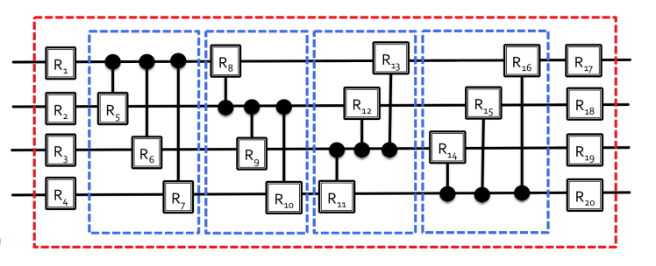
Encoding: The Architecture
Romero, Jonathan, Jonathan Olson and Alan Aspuru-Guzik. Quantum autoencoders for efficient compression of quantum data. Scientific Paper. Harvard University. Cambridge, 2017.

Slide 11


Cost Function and Optimiser
Naïve approach
Swap Approach
Compare the input with output and the cost function is the overlap
Cost is now overlap between the reference state and trash state
Romero, Jonathan, Jonathan Olson and Alan Aspuru-Guzik. Quantum autoencoders for efficient compression of quantum data. Scientific Paper. Harvard University. Cambridge, 2017.

Slide 12
Decoding
Swap the reference with trash states
Apply the conjugate transpose of the unitary architecture

Slide 13
Results

Slide 14
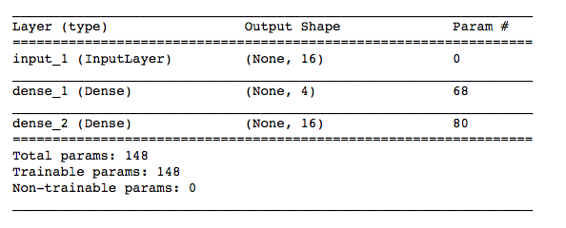
Classical auto-Encoders
Optimizer: SGD-variant (adadelta)
Losses Searched: Cross-Entropy, Mean_Squared_Error

Slide 15
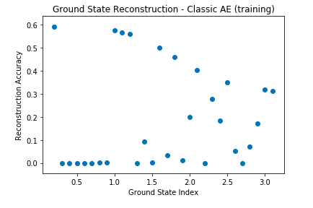
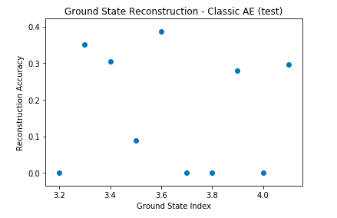
Classical auto-encoders (CONT’D)

Slide 16
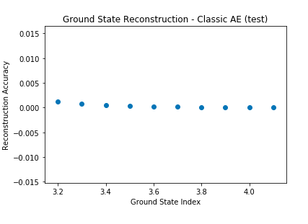
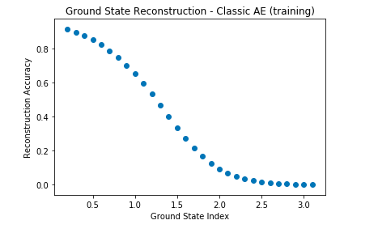
Classical auto-encoders (CONT’D)
Notes:
Classical auto-encoders can overfit some of the patterns (at small R), but fails to generalize. Seems like classical auto-encoders can at best act as A lookup table for this quantum data

Slide 17
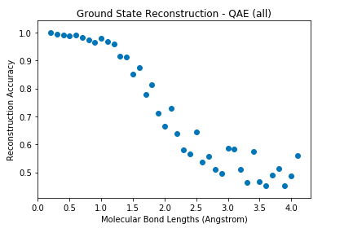
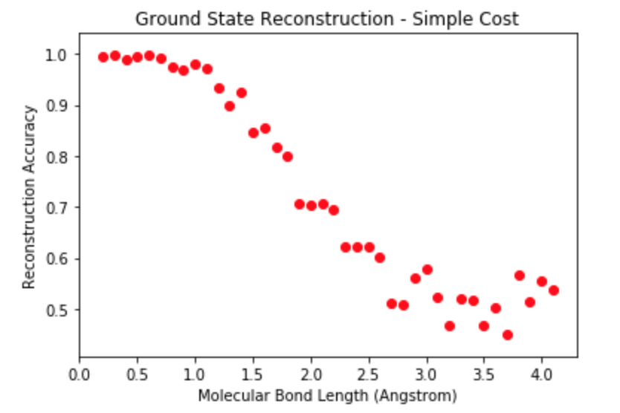
Reconstruction Accuracy
Cost Function: overlap between Trashed and Reference States
Cost Function: overlap between Input and Reconstruction

Slide 18
Quantum versus classical
Training on 10 ground states with the QAE, we were able to reconstruct all ground states with accuracies from 50-100%
Ground states with smaller molecular bond lengths yielded better reconstructions
Can overfit some of the ground states + reconstructions with a Classical Auto-Encoder using Kullback-Liebler divergence loss, but it fails to generalize
Notes:
Recommender algorithms especially
This makes it difficult to compress these states onto lower dimensions for storage.

Slide 19
Challenges
Hyperparameter search - determining an appropriate reference state
Develop a scalable architecture

Slide 20
References
Augusta, Carolyn. Training Deep AutoEncoders for Collaborative Filtering. 5 September 2016. May 2018. <https://statisticalinterference.wordpress.com/2016/09/05/autoencoders-and-matrix-factorization/>.
Ginsburg, Boris and Oleksii Kuchaiev. "Training Deep AutoEncoders for Collaborative Filtering." Scientific Paper. 2017.
Romero, Jonathan, Jonathan Olson and Alan Aspuru-Guzik. Quantum autoencoders for efficient compression of quantum data. Scientific Paper. Harvard University. Cambridge, 2017.
Valkov, Venelin. What to do when data is missing? - Part II. 2 February 2017. May 2018. <http://curiousily.com/data-science/2017/02/02/what-to-do-when-data-is-missing-part-2.html>.

Slide 21
The end
Questions?
Comments?
Find the project on github at: https://github.com/lisachille/ENG-SCI170-Project

Slide 22
OpenFermion - Generate Molecular Data + Hamiltonians
from openfermion.hamiltonians import MolecularData
from openfermion.transforms import get_sparse_operator
from openfermion.utils import get_ground_state
r = [ 0.2, 0.3, 0.4, 0.5, 0.6, 0.7, 0.8, 0.9, 1. , 1.1, 1.2, 1.3, 1.4, 1.5, 1.6, 1.7, 1.8, 1.9, 2. , 2.1, 2.2, 2.3, 2.4, 2.5, 2.6, 2.7, 2.8, 2.9, 3. , 3.1, 3.2, 3.3, 3.4,3.5, 3.6, 3.7, 3.8, 3.9, 4. , 4.1]
# Generate and populate instance of MolecularData. molecule = MolecularData(geometry, basis, multiplicity, description="1.45") molecule.load()
molecular_ham = molecule.get_molecular_hamiltonian()
molecular_ham_sparse = get_sparse_operator(operator=molecular_ham, n_qubits=4)
ground_energy, ground_state = get_ground_state(molecular_ham_sparse)

